Slide 1
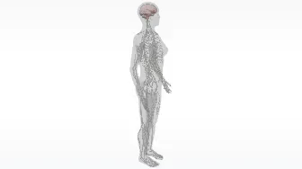
The Nervous System
AEPSY Year 11 ATAR Psychology

Slide 2
Introduction
Course outline and assessment outline
Study requirements
Expectations

Slide 3
Study skills
Pre-reading
Glossary
Concept maps
Practise exam style questions

Slide 4
Learning Intentions
Structural organisation of the nervous system
central nervous system – brain and spinal cord
peripheral nervous system – somatic and autonomic

Slide 5
Success Criteria
State the function of the nervous system
Name components of the CNS and PNS
Label CNS and PNS on anatomical diagrams
Compare functions of CNS and PNS

Slide 6
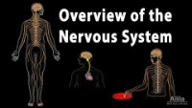

Slide 7
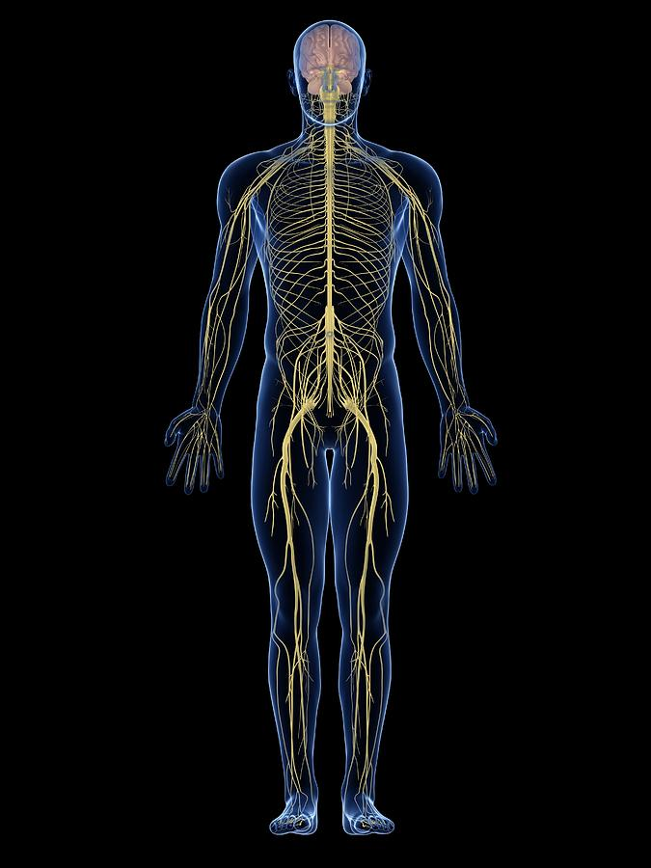
Nervous system
The nervous system is the highly complex part of an animal that coordinates its actions and sensory information by transmitting signals to and from different parts of its body. The nervous system detects environmental changes that impact the body, then works in tandem with the endocrine system to respond to such events.

Slide 8
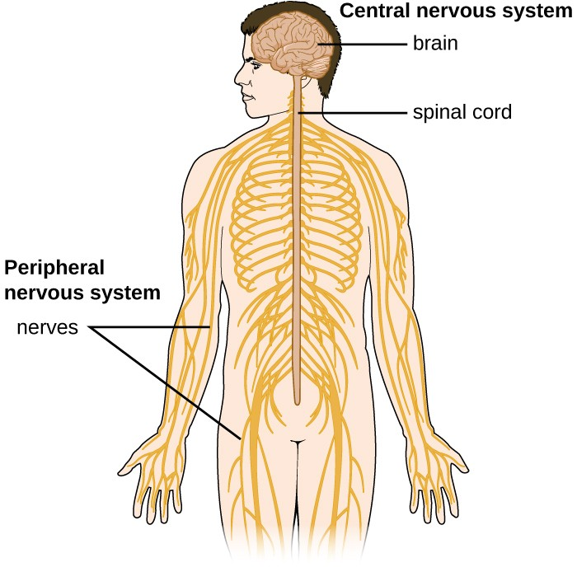

Slide 9
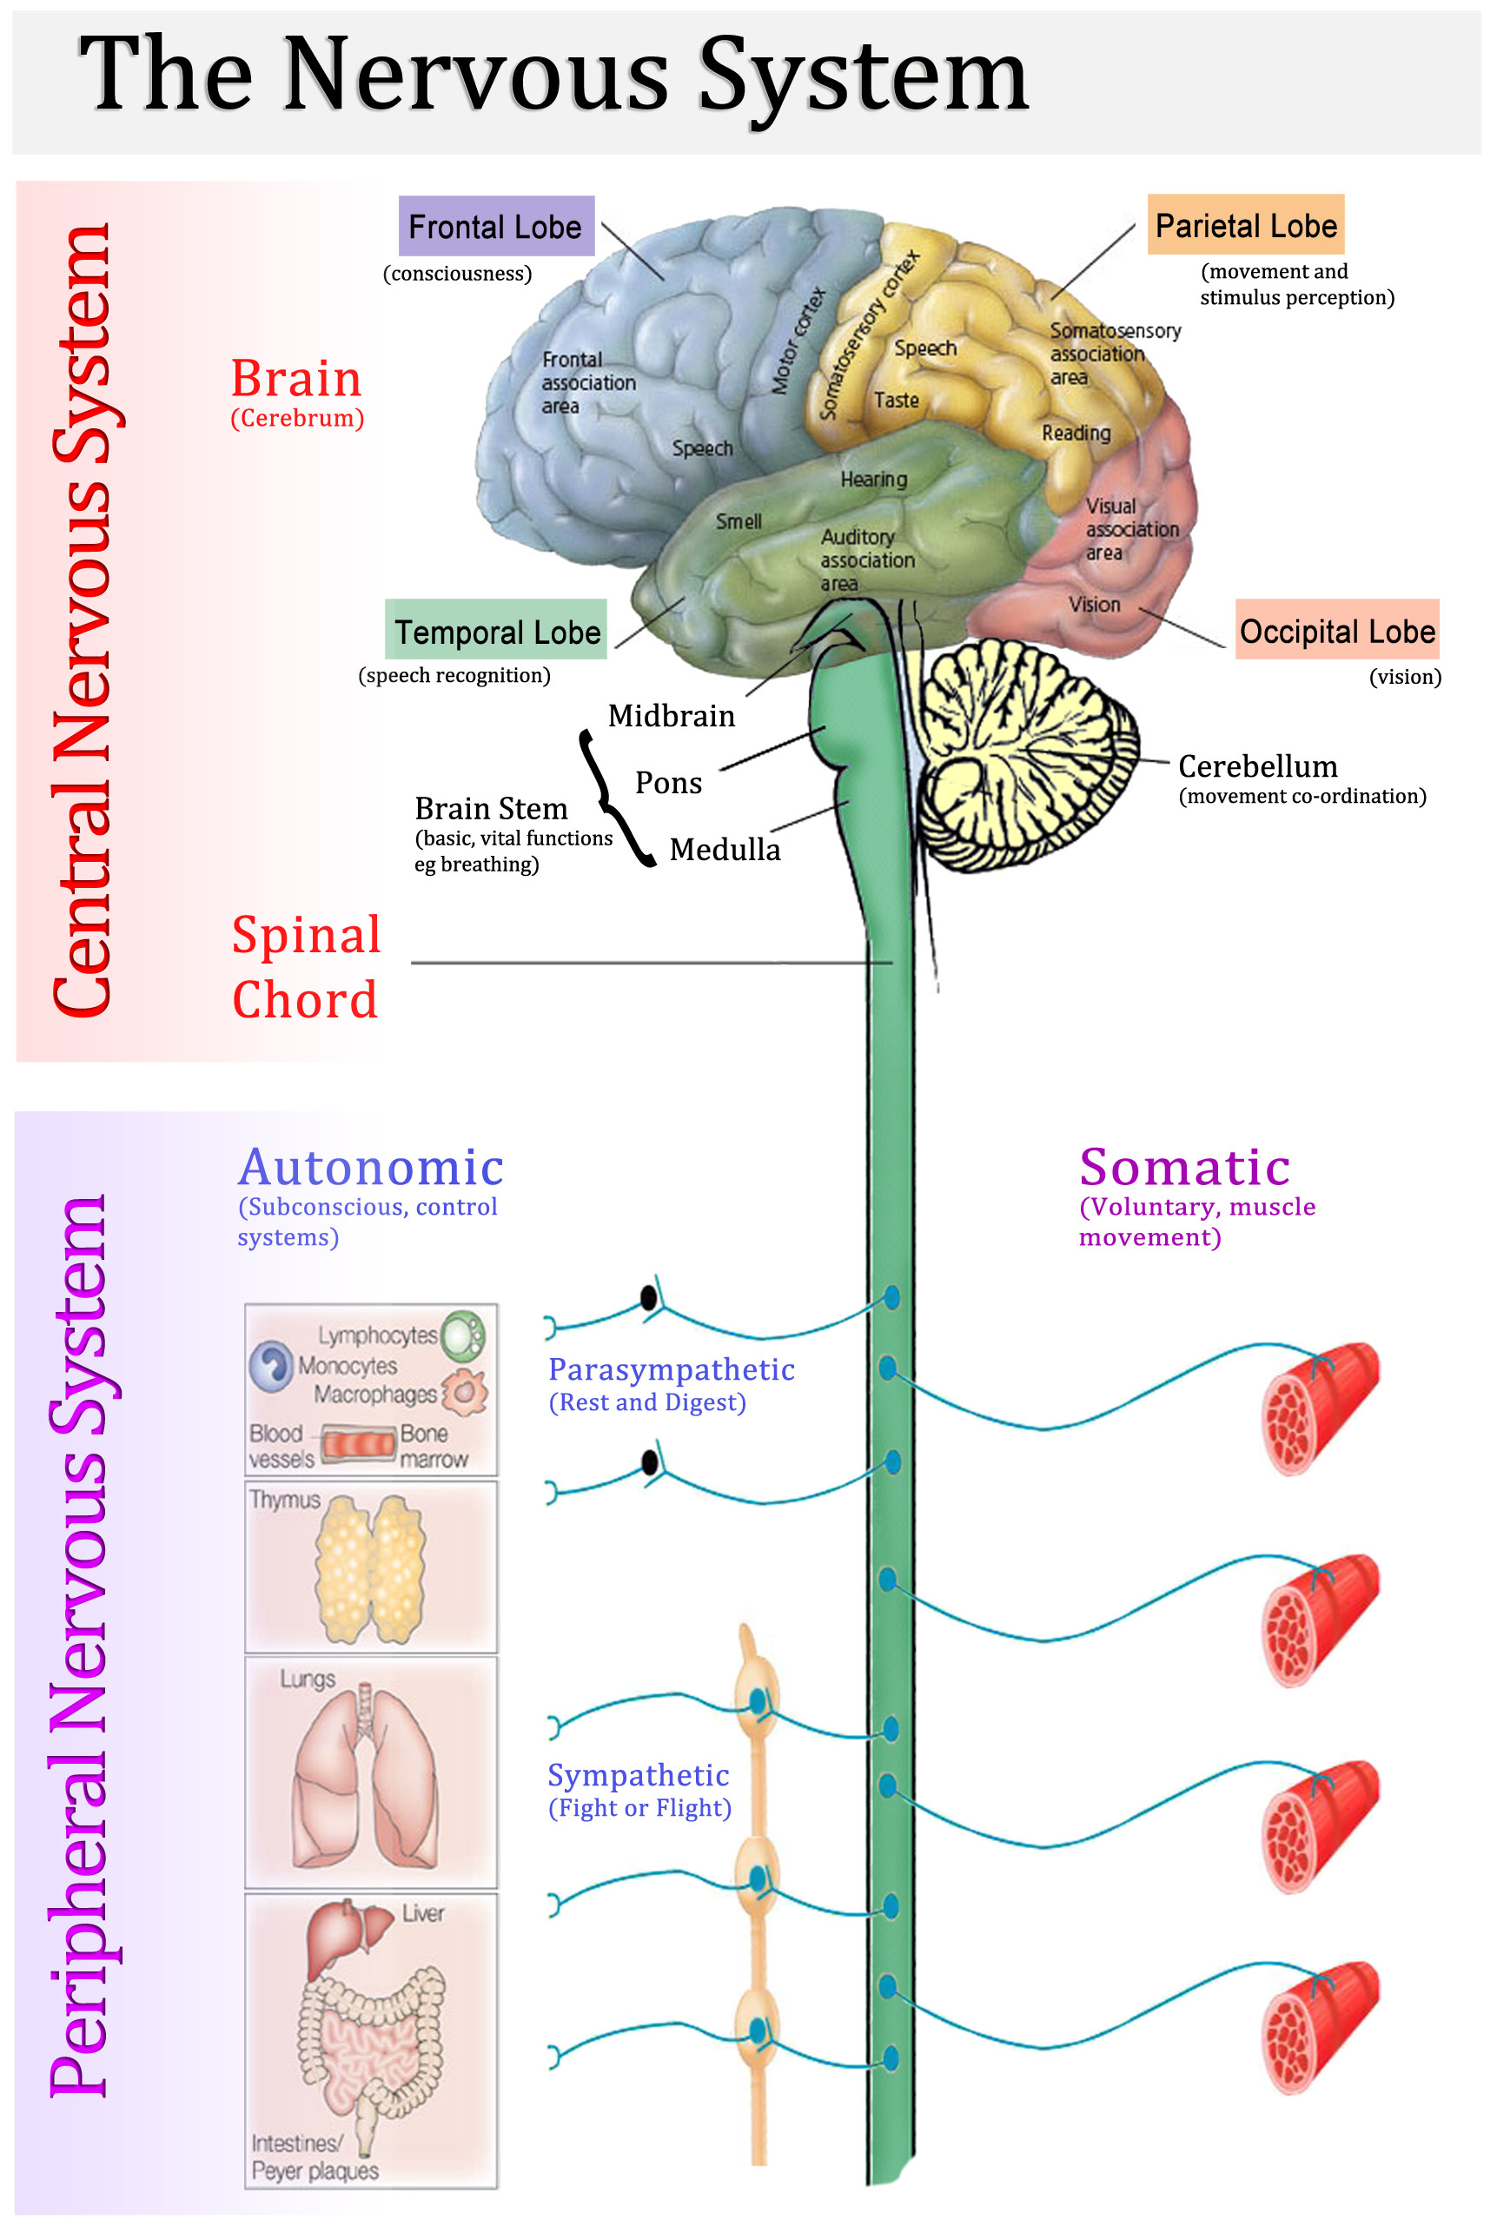



Slide 10
Success Criteria
State the function of the nervous system
Name components of the CNS and PNS
Label CNS and PNS on anatomical diagrams
Compare functions of CNS and PNS

